Slide 1

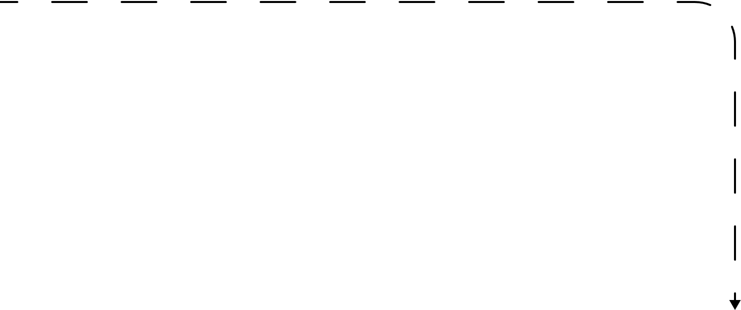



1
Challenge
Misalignment of IGNITIVE definition, purpose, and utility
Description/ Current Status
2
IGNITIVE is not viewed as a way of working. Very few, if any, project teams outside of DSAI are utilizing the framework, documentation strategies, etc.
Description/ Current Status
Agree upon a clear definition of IGNITIVE for DSA
2. SLT/LT are held accountable for following IGNITIVE if a project is selected through check-ins (e.g., project charter, rubric, documentation, etc.)
3. Not all projects are IGNITIVE
We need to track the value as an incubator we’re adding through this process – quantitative and qualitative metrics. It’s not just experimentation, we’re providing the organization leads for use cases which have the highest potential to become enterprise solutions (which folks like mckinsey are hungry for)
3

Slide 2
1
Challenge
Lack of quality incubation ideas
Description/ Current Status
2
Projects are not being selected, prioritized, or resourced by SLT/LT.
Description/ Current Status
1. Establish guidelines that drive higher quality submissions (e.g., submissions should have a known stakeholder and business value)
2. Remove the 2/LT quota – instead, have each team head pick 2-3 most promising ideas per month and submitted through Ignitive anonymously – this will foster individual & group think
3

Slide 3
1
Challenge
Communication regarding project selection and prioritization
Description/ Current Status
2
IGNITIVE is not viewed as a way of working. Very few, if any, project teams outside of DSAI are utilizing the framework, documentation strategies, etc.
Description/ Current Status
1. After ideas are vetted for feasibility purposes by DSAI, DSAI and the SLT member for the project submission align on project priority and resourcing, and they communicate to the required DSA members (including a PM)
2. IGNITIVE projects should include members of the DSA vertical in which the final product will sit – to ease transition process outside of DSAI
3. Ignitive should become a standing agenda item at the LT meetings for SLT/LT to align and get sponsorship on important use cases
3

